Slide 1








Powered By BigJobs
Pay Only for What You Use
HIRE SMARTER & FASTER WITH AI-POWERED VIDEO INTERVIEWS
WHAT IS
EVALSY?
Evalsy is an AI platform that automatically interviews and shortlists candidates — saving you time, cost, and effort in hiring.
Up to 70% Lower Hiring Costs
Trusted by 50+ Clients Worldwide
AI Scoring with Ranked Shortlists
Hire 5x Faster with 24/7 Interviews
www.evalsy.com

Slide 2






Features
Why Choose Evalsy?
Automated Video Interviews 24/7
Real-Time Fraud Detection
Candidates can take interviews anytime that works for them. No need for scheduling or live coordination—everything is handled automatically, and you can review responses when you're ready.
We help keep your hiring process fair by spotting things like impersonation or off-camera help during interviews. You’ll get alerts if something doesn’t seem right.
AI-Driven Candidate Scoring
Detailed Interview Analytics
Our system reviews answers and highlights the top candidates based on how well they match your job requirements. It saves you time and helps you focus on who really fits.
See how each candidate performed, from response quality to communication style. Our analytics give you a clear view to support better hiring decisions.

Slide 3



SAVE UP TO
65%
For CEOs & HR Leaders
RECRUTIEMNT
COST
Optimization & Reduction
Cost
Optimization
Save up to 60% in recruitment
Overhead Minimize interviewer hours with automation
Time-to-Hire
Reduction
Instantly screen hundreds of candidates
Shortlist only the top talent for final rounds

Slide 4



1. AI Video Interviews
Features
Auto-schedule and auto-conduct interviews
Candidate responses recorded and analyzed in real time
Key Features
2. Smart Resume Shortlisting
Instantly ranks candidates based on job fit
Eliminates manual resume screening
3. AI Interview Scoring & Feedback
Score candidates based on communication, confidence, and skills
Visual scorecards and actionable insights
4. Fraud Detection Engine
Flags suspicious behavior
Protects the integrity of the hiring process

Slide 5
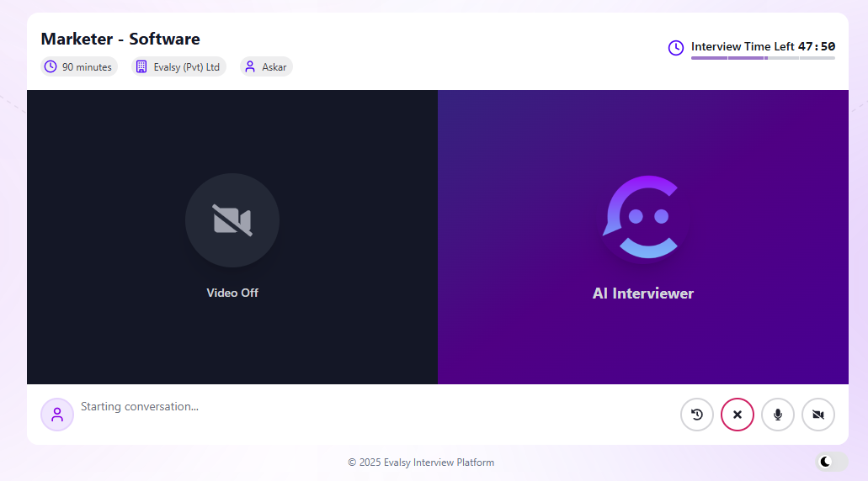

Recording
Real-Time AI Interview Recording – No Human Panel Needed
Live Question & Answer FlowSkill Breakdown
Natural-Language ConversationVideo Recording Panel
Instant Response Analysis

Slide 6
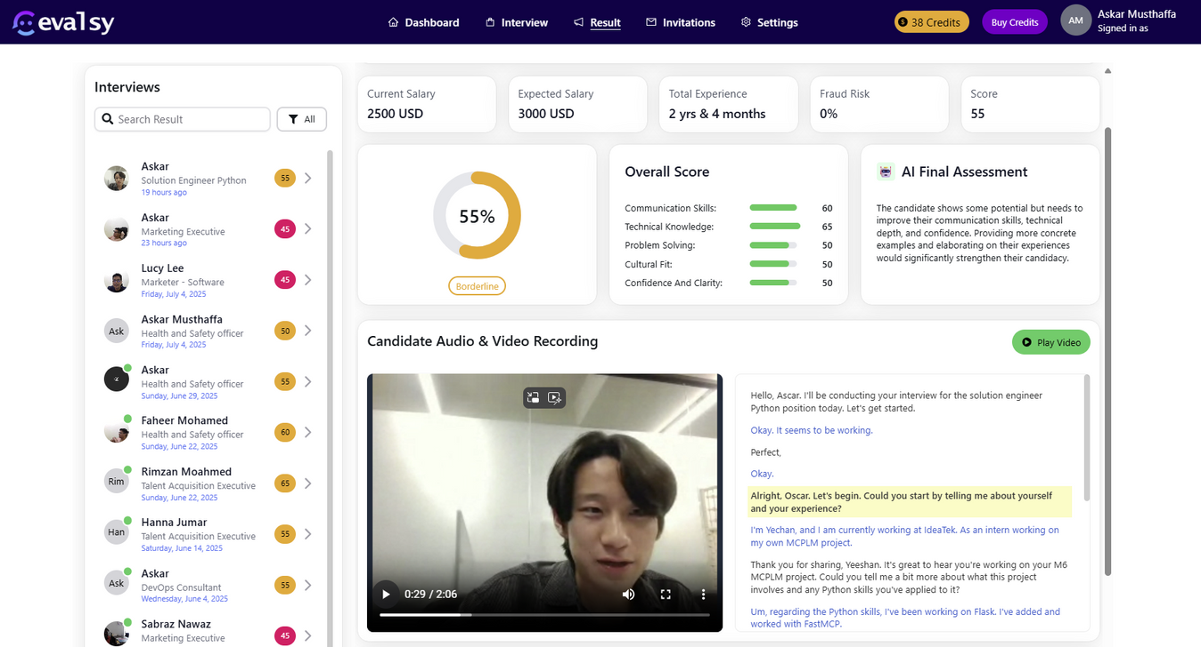

Summary
AI-Powered Interview Summary
Candidate Profile Insights
Skill Breakdown
AI Final Assessment Summary
Video Recording Panel
Interactive Transcript

Slide 7







Testimonials
Wha our client say about us
Naveen Rajapaksa
Jessica Moore
Recruitment Director
Head of Talent, New York
"We used to waste weeks screening resumes. The AI makes hiring so much faster I wonder how we worked without it."
"Hiring has never been this smooth! With AI automation, we now find top talent faster than ever. Truly effortless and efficient."
Brandon Scott
Head of Talent, New York
Siti Nurhaliza
"Evalsy is an AI game-changer. The AI handled everything from screening to scheduling, saving us hours of manual work."
Talent Ops
"This tool transformed how we hire entire teams. With AI automation, we found top talent without breaking a sweat. It’s a complete game changer for our team."
Cheryl Tan
HR Manager
Mei Ling Ong
"From pipeline to onboarding, the trend in our hiring success has skyrocketed, especially when paired with Evalsy’s AI Interviewer."
Hiring Lead
"I was blown away by how simple the hiring process became. The AI did the heavy lifting, letting me focus on choosing the best candidates."

Slide 8
Pricing
Simple, Usage-Based Pricing
Free Trial
Credit Packages
Pay-as-You-Go
10 free credits
Unlimited job postings
Full access to AI interviews
Cancel anytime, no commitment
50 Credits –$10
200 Credits –$35
500 Credits –$75
Credits never expire
Resume screening – 1 credit per resume
Manual interview invite – 3 credits
AI voice interview – 1 credit per minute
Real-time usage tracking in your dashboard

Slide 9
Contact
Your AI Interviewing Partner
Contact Info
team@evalsy.com
+947 790 5939 4
www.evalsy.com

